Slide 1
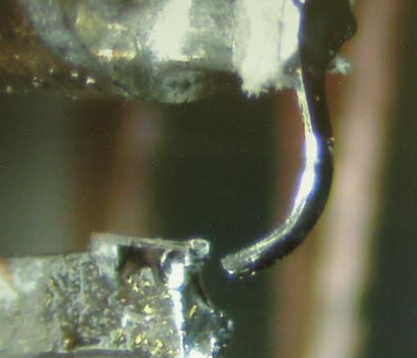
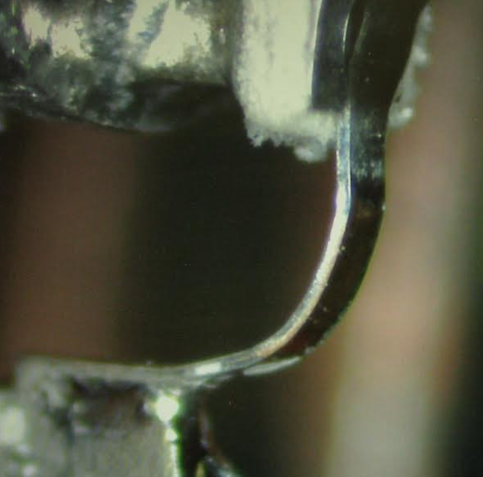
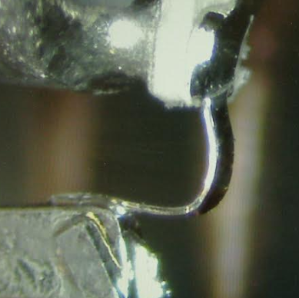
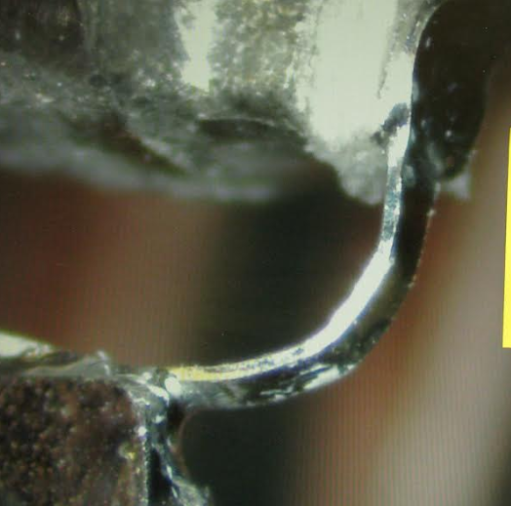
020 Feed damage
Images from Matt 8/15/2019
X failed after delivery to HCRO
Rexolite standoffs were replaced and tip fixed at MINEX
Nominally there is no spacing between the Rexolite and copper elements
Slight natural offset of pyramid exists w.r.t. Feed Arms, according to Matt
X+ image shows loading and shear fracture
X+
Y+
X-
Y-
GD-SSL 20190816

